Slide 1
Battle of Neighbourhoods
By: Seema Negi

Slide 2
Content
Project Idea
Target Audience
Data Acquisition
Data Preprocessing
Feature Extraction
K-Means Clustering
Results
Discussion
Future Improvements

Slide 3
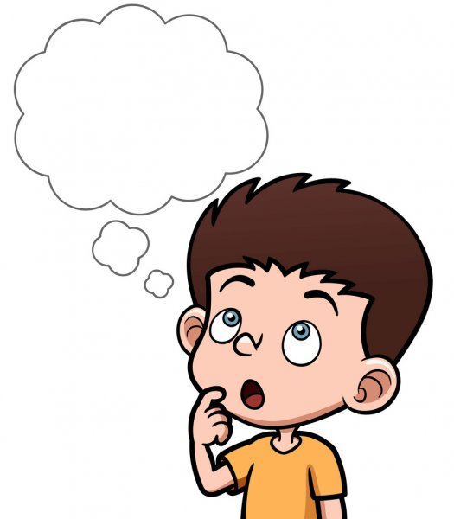
Project Idea
Which location would be better to relocate?
The aim of the project is to make the planning of relocation easier, by studying and analyzing the neighborhoods of Toronto city and group them into similar clusters on the basis of nearby common venues.

Slide 4
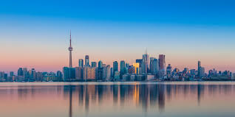
Target Audience
Individuals who are planning to relocate to Toronto or within the neighbourhoods of Toronto.

Slide 5
Data Acquisition
For the Toronto neighborhood data, a Wikipedia page exists https://en.wikipedia.org/wiki/List_of_postal_codes_of_Canada:_M
To get the geographical coordinates of the neighborhoods , a csv file http://cocl.us/Geospatial_data is used
FourSquare API explore function to get the nearby venues in the neighbourhood

Slide 6
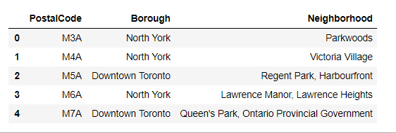
Data Preprocessing
Wikipedia page is scraped and shown dataframe is created.
Columns containing ‘Not Assigned ’ values are removed

Slide 7
Data Preprocessing
The csv containing the geographical coordinates of the neighborhood is read using python pandas library. The resulting data frame is further merged with the the dataframe containing data of neighbourhood.
Python geopy library can be used to get the geographical coordinates(longitude, latitude) of Toronto

Slide 8
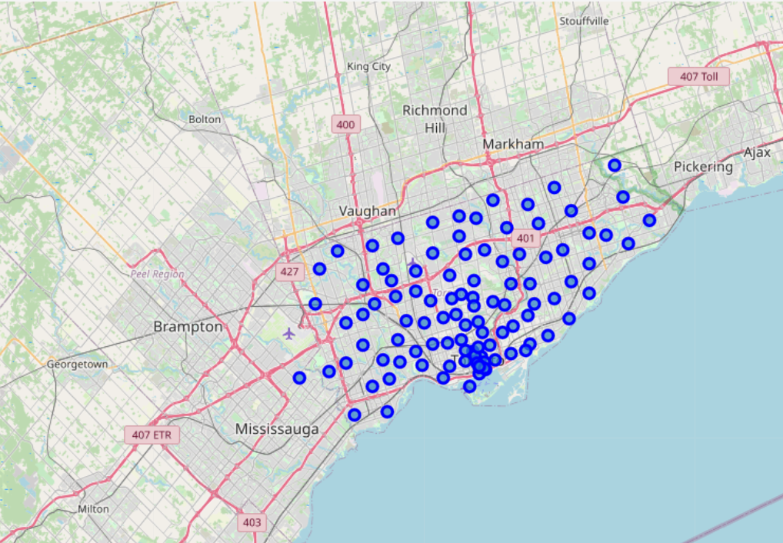
Map of Toronto
Map of toronto created using Folium library with neighborhoods superimposed on top

Slide 9
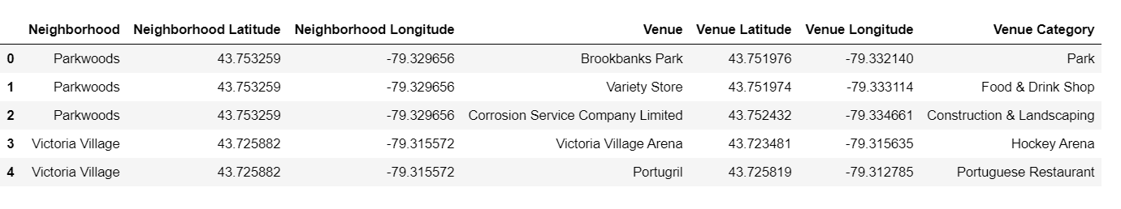
Feature Extraction
FourSquare API is used to fetch venues within a radius of 500 of neighbourhood

Slide 10
K-means Clustering
K-means Clustering is used to divide the data into k non-overlapping subsets or clusters.
Library Used for modelling:- sklearn.cluster.KMeans
5 clusters are obtained

Slide 11
Results

Slide 12
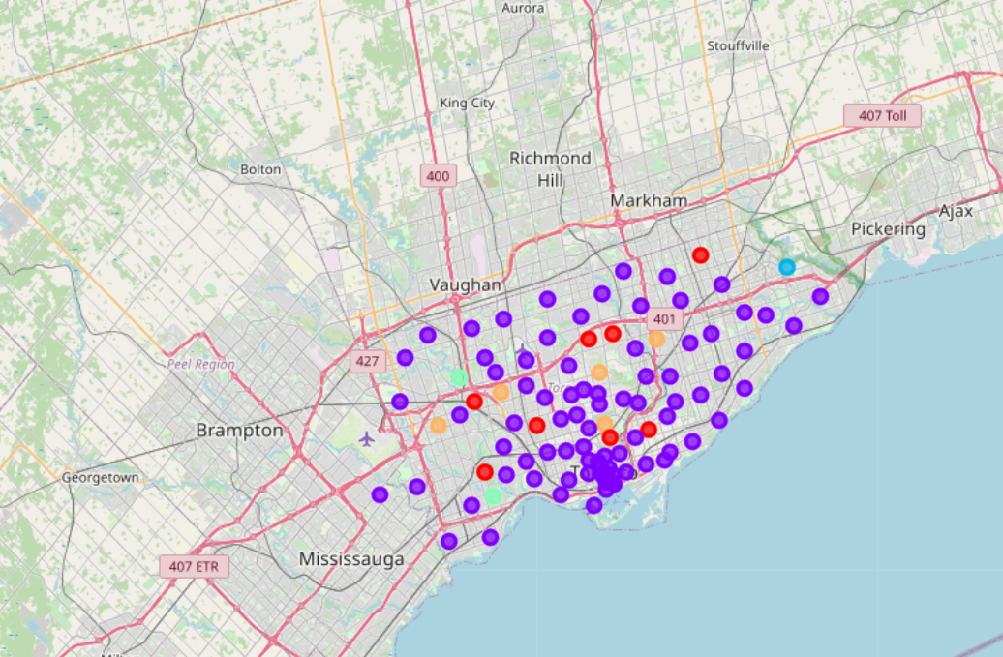
Map showing different clusters.

Slide 13
Cluster Analysis

Slide 14
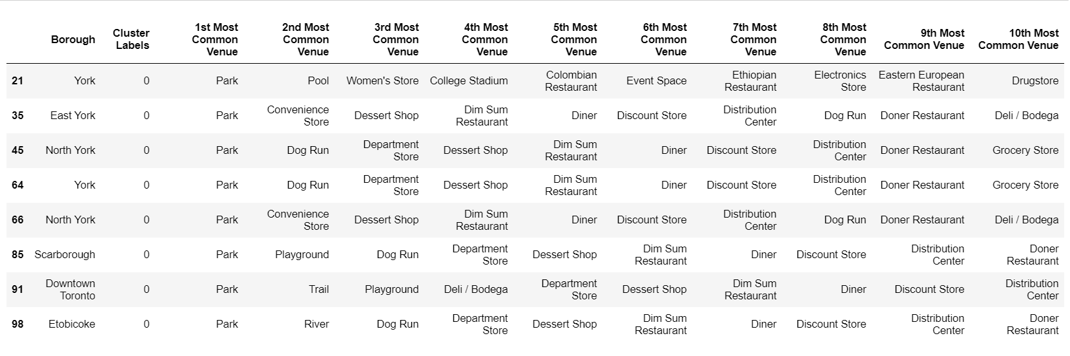
Cluster 1
This cluster mostly consists of venues like Park, Playground, Department Store, Distribution Center and similar venues

Slide 15
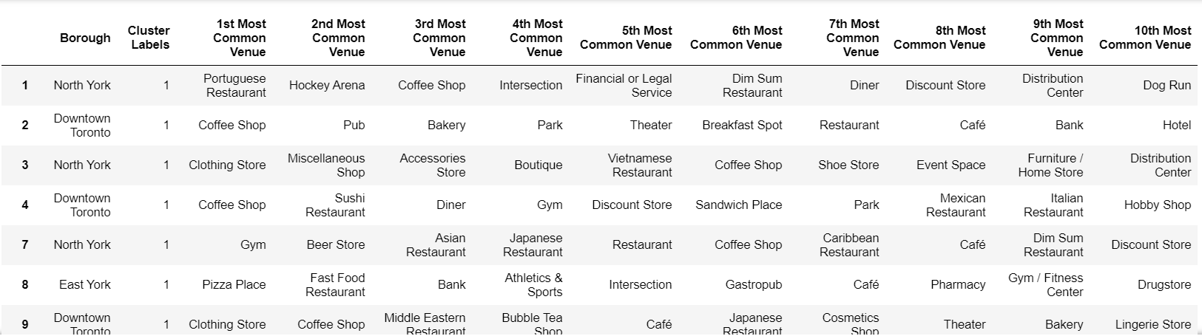
Cluster 2
Cluster 2 mostly consists of Restaurants of different types, Coffee shops, cafe, Beer store and similar venues

Slide 16
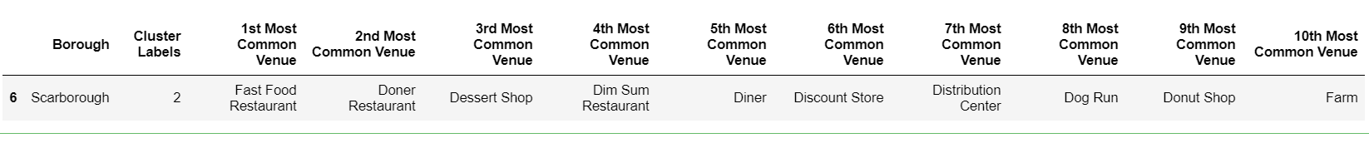
Cluster 3
Cluster 3 contains only one neighbourhood.

Slide 17
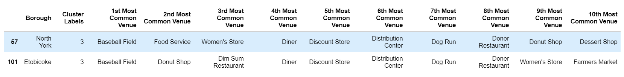
Cluster 4
Cluster 4 contains only 2 neighbourhoods of with similar common venues

Slide 18
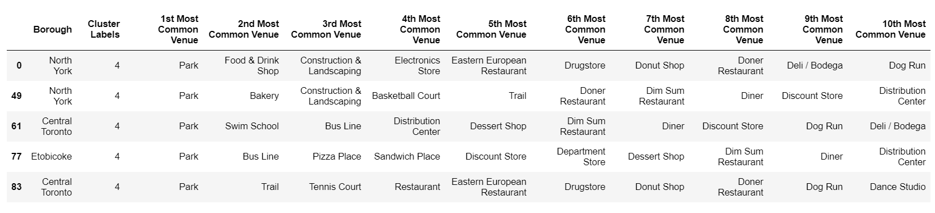
Cluster 5
Cluster 5 contains venues like Park, Restaurants, Bus line, Dog Run and etc

Slide 19
Discussion
It can be observed that Cluster 1 and 5 have many venues in common while Cluster 3 can be combined with Cluster 2.
Results can be used for selecting a neighbourhood to relocate on the basis of preferred venues.

Slide 20
Future Improvements
More features can be extracted
Different machine learning algorithms and comparison
More data to work on
The approach can also be used to solve a specific business problem like best place to open a new restaurant or some other service.

Slide 21
Thank You

